Slide 1
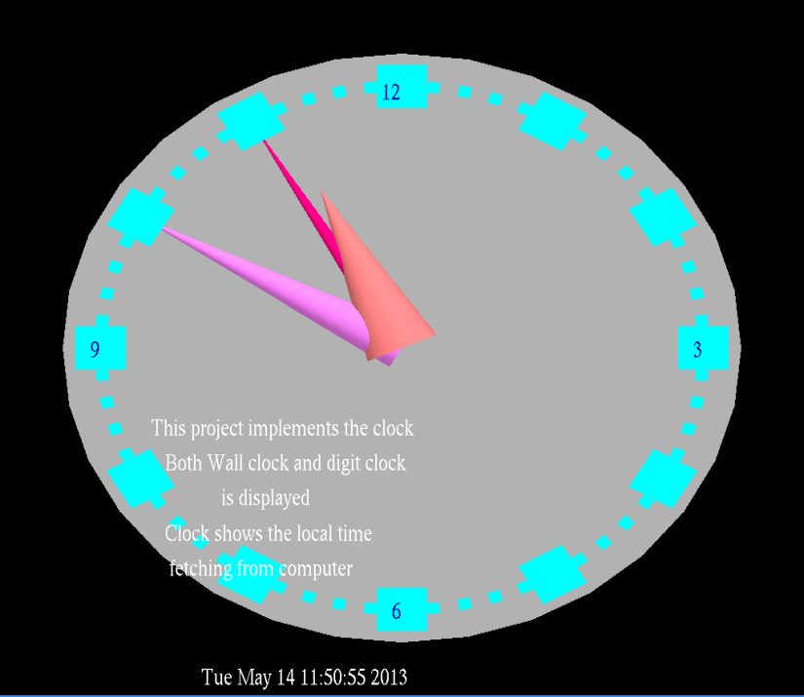
CLOCK using OpenGL
Presented by
DHRUVA M (1AY10CS017)
Under the guidance of
Prof. NARASIMHA MURTHY M S, Prof. VANI K S,
Prof. SUREKHA K B, Prof. SRINIVASULU M
(Assistant Professors)
DEPARTMENT OF COMPUTER SCIENCE & ENGINEERING
ACHARYA INSTITUTE OF TECHNOLOGY

Slide 2

AGENDA
Abstract
Introduction
System Requirements
About the project
Detailed Design
Implementation
Testing and Results
Conclusion
Future Enhancement
References

Slide 3
ABSTRACT
This mini project on CLOCK displays an analog as well as a digital clock by reading the time from the system in which it runs.
It implements the wall clock with the round circular board and three conic geometrics which forms the different (sec, min & hour) hands.
Small cubes are also made for the minutes, while each hour is represented with a large block.
Digit display of the clock timing is also placed at the bottom of the graphics window.

Slide 4
INTRODUCTION
Computer Graphics is concerned with all aspects of producing pictures or images using a computer. We can create images that are indistinguishable from photographs of real objects. In other terms, Computer Graphics are the graphics created by the computers, and more generally, the representation and manipulation of image data by a computer.
OpenGL is a software interface to graphics hardware. The OpenGL specification describes an abstract API for drawing 2D and 3D graphics. OpenGL is an evolving API. New versions of the OpenGL specification are regularly released by the Khronos Group, each of which extends the API to support various new features.
GLUT is the OpenGL utility toolkit, a window system independent toolkit for writing OpenGL programs. It implements a simple windowing API for OpenGL.
The OpenGL API is typically used to interact with a GPU, to achieve hardware-accelerated rendering. It is widely used in CAD, virtual reality, scientific visualization, information visualization, flight simulation, and video games.

Slide 5
SYSTEM REQUIREMENTS
Hardware Requirements:
Pentium 90MHz Processor or Higher
VGA 640x480 or higher-resolution screen supported by Microsoft Windows.
Recommended 128 MB RAM or Higher (24 MB RAM for Windows 95/98, 32 MB for Windows NT)
100GB SATA (Serial Advanced Technology Attachment) Hard Drive
5400 RPM hard disk drive
DirectX 9 capable video card running at 1024 x 768
DVD-ROM Drive
Input devices: Keyboard, Mouse.
Output devices: Monitor.
Software Requirements:
Operating System: Microsoft Windows NT 4.0 or later, or Microsoft Windows 95 or later.
Microsoft Visual Studio 6.0
glut.h header file
glut.dll library files

Slide 6
ABOUT THE PROJECT
This mini project on CLOCK displays an analog as well as a digital clock by reading the time from the system in which it runs. It implements the wall clock with the round circular board and three conic geometrics which forms the different (sec, min & hour) hands. Small cubes are also made for the minutes, while each hour is represented with a large block. Digit display of the clock timing is also placed at the bottom.
A function is used to get the local time. With proper mathematics and conversion of the time for sec, min and hours, the graphical hands are made to make movement. The user can toggle between two types of views, can enable or disable the background brightness of the clock and also can view a small description about the project on the graphics window.
A function TimeEvent() displays the needles of the clock as per the current time read by the program.
A function Draw_clock() is used to draw the analog wall clock on the screen.
A function num() displays the numbers on the clock according to orthogonal view.
A function about() displays a small description about the project when the user clicks the respective mouse button.
A function options() is used to display a menu along with options regarding the light state, view of the clock, description and perform the corresponding action.

Slide 7
DETAILED DESIGN
START
MAIN
INITIALIZE CALLBACK FUNCTIONS
MAIN SCREEN DISPLAYED
MOUSE
RIGHT CLICK
ABOUT
TOGGLE VIEW
LIGHT ON/OFF
QUIT
EVENTS
STOP

Slide 8
IMPLEMENTATION
The working of the program can be illustrated by the following abstract algorithm
Initialization
Initialize to interact with the windows.
Initialize the display mode.
Initialize window position and window size.
Initialize and create the window to display the output.
Every time window is resized, reshape function is called to redraw the output.
Menus and Sub-menus are created and depending on the value returned by Menus, the suitable operations are performed with the help of switch functions.
The project uses the following libraries
glut.h
string.h
stdio.h
math.h
stdlib.h
time.h

Slide 9
TESTING AND RESULTS
Sl. No. | Test Case Description | Expected Result | Actual Result | Remarks
1. | Click the RIGHT mouse button on the display screen. | Menu with Toggle Ortho/Perspective View Light ON/OFF About the project Quit should be displayed. | Menu with Toggle Ortho/Perspective View Light ON/OFF About the project Quit is displayed. | Pass
2. | Click on Toggle Ortho/Perspective view option | The user should be able to toggle between these two views. | The user is able to toggle between these two views. | Pass
3. | Click on Light ON/OFF option | The user should be able to turn ON or OFF the brightness feature | The user is able to turn ON or OFF the brightness feature. | Pass
4. | Click on About the project option | A short description of the project should be displayed on the window. | A short description of the project is displayed on the window. | Pass
5. | Click on Quit option | The window should be terminated. | The window is terminated. | Pass

Slide 10
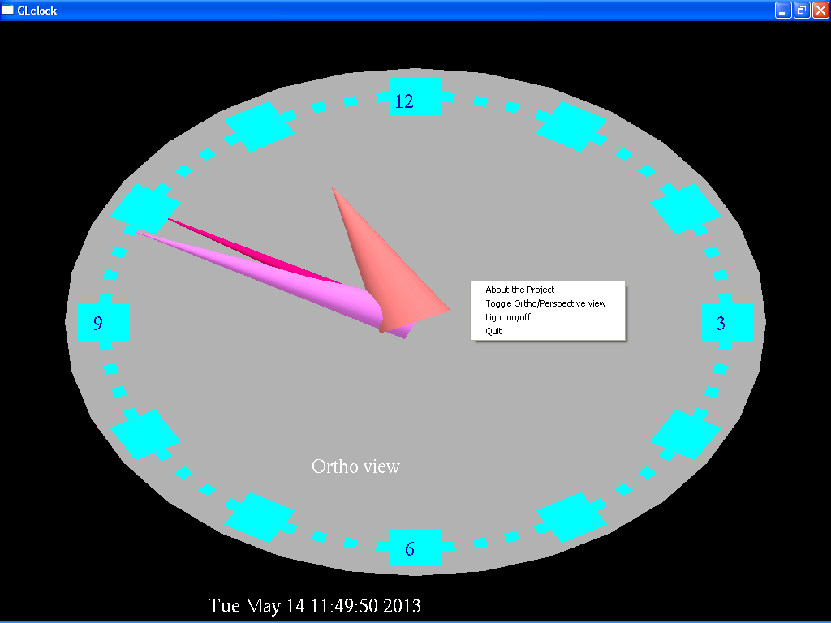
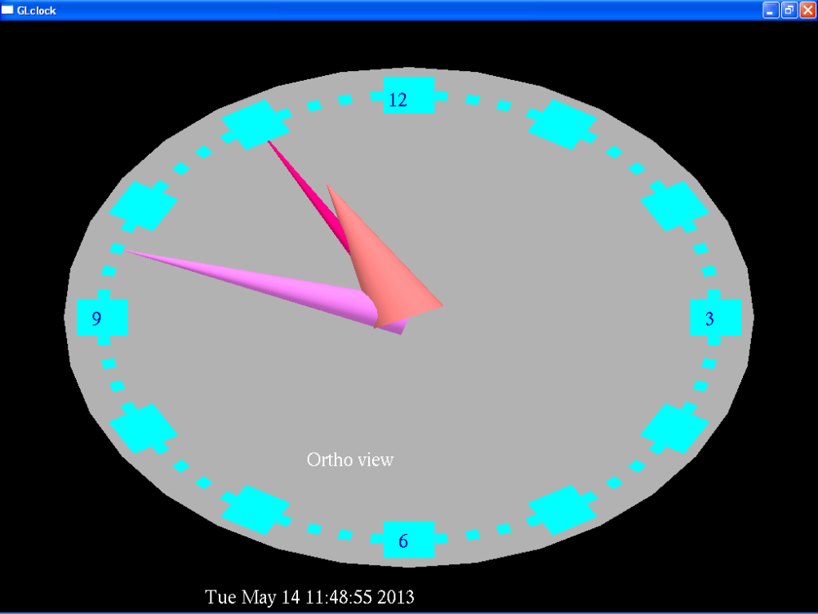
This window displays the clock with four different menu options on right click of the mouse regarding description, toggling between two views, light state, and an option to quit the window.
This is the initial view of the clock when the graphics window is opened. It shows the clock in Ortho view.

Slide 11
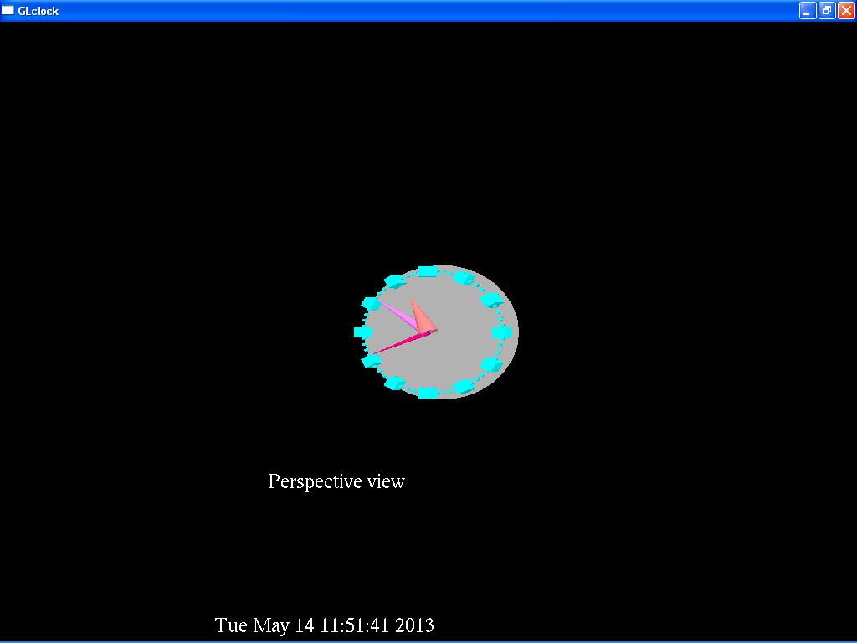
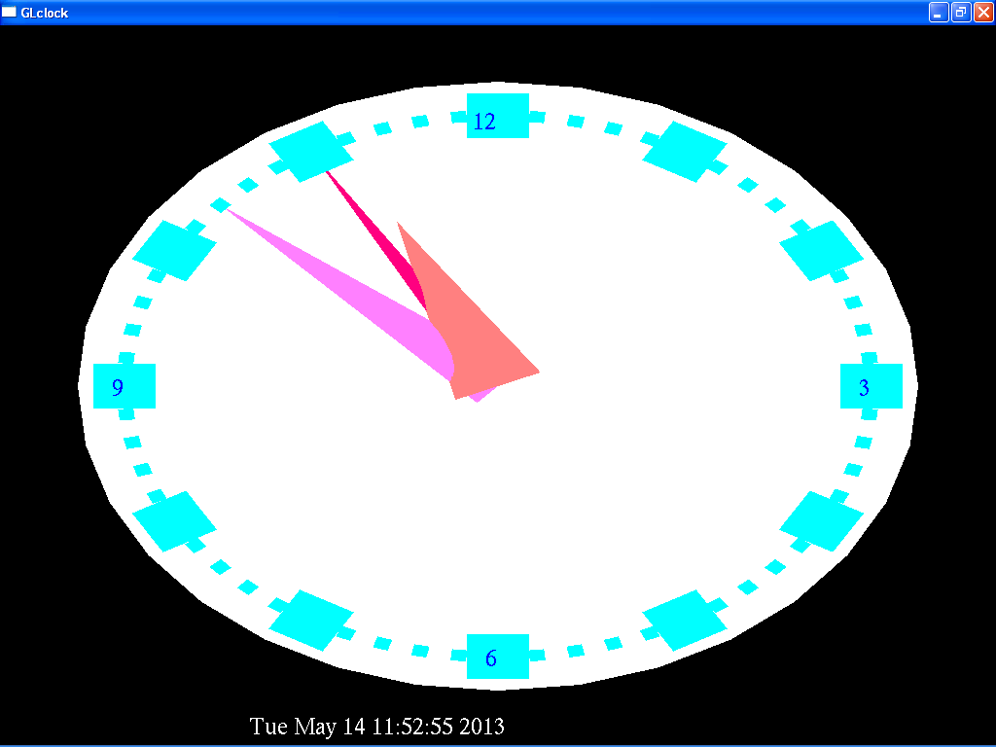
This window displays the clock in perspective view.
This window displays the clock with the background light ON.

Slide 12
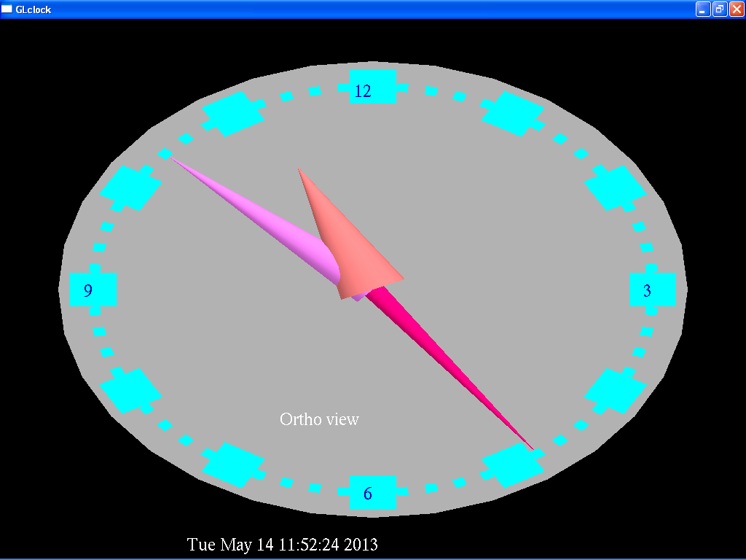
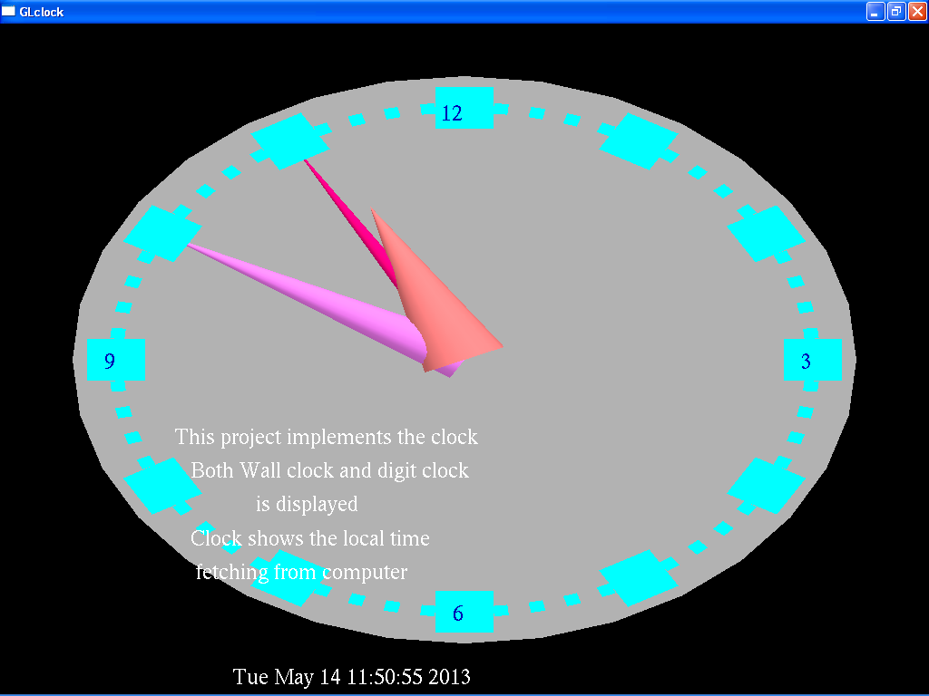
This window displays the clock with the background light OFF.
This window displays the clock with a short description about it.

Slide 13

CONCLUSION
This mini project on CLOCK using OpenGL is a reliable graphics package that provides the user with the basic working of an analog as well as a digital clock.
It provides the user with certain other operations like toggling between two different kinds of views, adjusting the brightness by turning the lights on or off, also allows the user to read a short description of what the project is about.
The user-friendly interface allows the user to interact with it very effectively.

Slide 14
FUTURE ENHANCEMENT
This project has been designed such that it works on the windows platform. The project can be designed using different languages and better graphical interfaces.
The following features can be incorporated.
A simple monthly calendar can be displayed along with the clock.
A simple digital timer can be implemented.
Better graphical features like options for the user to change the clock’s color and shape of the clock.
A different style for the digits on the clock, for example, Roman Numbers.

Slide 15
REFERENCES
BOOKS:
Edward Angel, “Interactive Computer Graphics”,5th edition, Pearson Education,2005
Jackie L. Neider, Mark Warhol, Tom R. Davies, ”OpenGL Red Book”, 2nd Revised Edition,2005
Donald D Hearn and M. Pauline Baker, “Computer Graphics with OpenGL”, 3rd edition.
F.S.Hill and Stephen M.Kelly,”Computer Graphics using OpenGL”, 3rd edition.
WEBSITES:
http://www.opengl.org
http://en.wikipedia.org/wiki/OpenGL
http://basic4gl.wikispaces.com
http://openglprojects.in

Slide 16
Thank You

